Slide 1

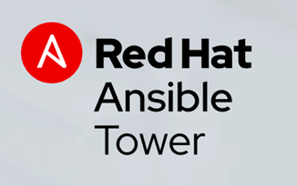
Automation with Ansible Tower

Slide 2
Contents
Day-1
Ansible Introduction
Ansible AWX Vs Ansible Tower
Ansible Tower Features
CACF – Architecture overview
YAML & Playbook Intro
Day - 2
Deployment Models
Pre-boarding checklist
Continuous Engineering & Asset Catalogue
Playbook Use cases
Demo on AT.
Q & A
Day - 3
Playbook Use cases
Demo on AT
Q & A
S&R Use cases for Workshop.
Day - 4
Workshop

Slide 3
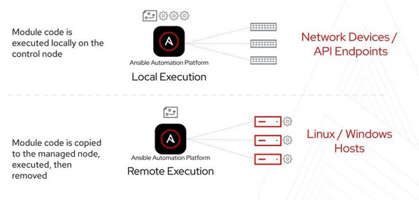
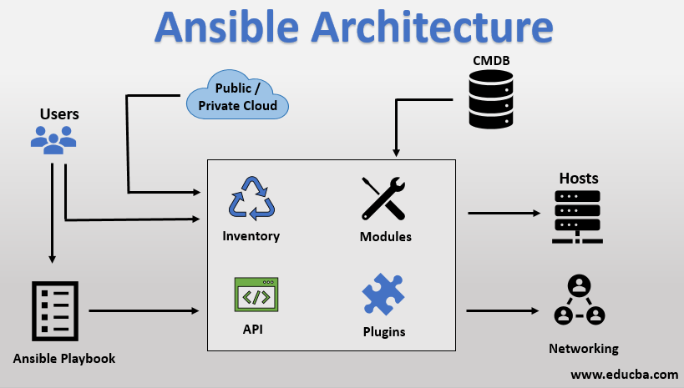
Ansible
Ansible® is an open source, command-line IT automation software application written in Python.
It can configure systems, deploy software, and orchestrate advanced workflows to support application deployment, system updates, and more.
Ansible’s main strengths are simplicity and ease of use. It also has a strong focus on security and reliability, featuring minimal moving parts.
It uses OpenSSH for transport (with other transports and pull modes as alternatives) and uses a human-readable language that is designed for getting started quickly without a lot of training.
Links: https://www.ansible.com/overview/how-ansible-works

Slide 4
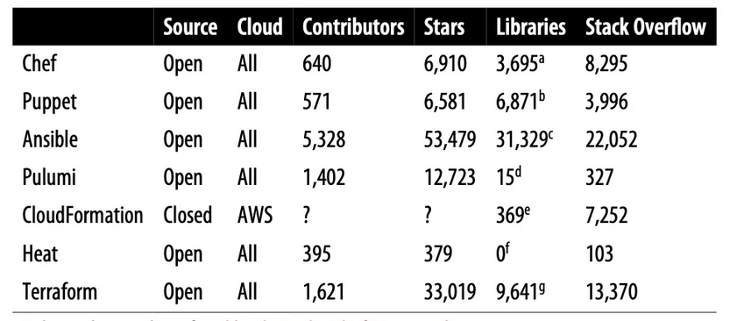
Ansible
Ansible Vs Terraform Vs Chef Vs puppet.
Chef & Puppet are agent based.
Ansible and Terraform were agentless.
Configuration management: which means they are designed to install and manage software on existing servers.
Provisioning: Both Terraform and Ansible supports the provisioning capability.
Links: https://www.ansible.com/overview/how-ansible-works

Slide 5
Ansible Vs Ansible Tower (AAP)
Ansible Tower is the full-blown commercial product that is supported by Red Hat and offers what you would expect from a ‘pay for’ product providing tooling or other automation services, including support
Pros
Fully supported
Release cycles
Fully tested for quality and engineering issues before release
Provides a 10-node free license with full enterprise features
Install/upgrades are well-documented and supported
Loaded with features which is ideal for the production environments.
Cons:
It is expensive ($13000/17500 per year/100 node )
May be overkill for what you are trying to do
Ansible AWX is the open-source GUI Ansible automation tool from Red Hat that allows you to be able to have basically all the features and functionality from Ansible Tower in a freely available format. In fact, it is noted from Red Hat that Tower is based on AWX. Let’s look at the pros and cons of Ansible AWX.
Pros
Full enterprise features and functionality of Tower
This is a free download
Not limited to 10 nodes
Great for POC/dev/lab environments
Cons
Not supported
Multiple releases in a single day are possible
Not yet in lock-step with Ansible Tower releases
Not a good choice for production environments

Slide 6
Features of Ansible Tower(AAP)
A GUI dashboard
Role-based access control
Job scheduling
Graphical inventory management
Multi-playbook workflow
REST API
External logging integrations
Real-time job status updates
Access to Red Hat Technical Support team and the Customer Portal
Ref Link: Ansible Tower User-Guide

Slide 7
Summary of day - 1
A GUI dashboard
What is Ansible ?
How it works ?
Ansible Vs Ansible Tower ( AAP )
Features of Ansible Tower
Some basic understanding of YAML or playbooks.
Ansible community – Galaxy.
GitHub repo creation
Using the Ansible Test Lab.
Ref Link: Ansible Tower User-Guide

Slide 8








Cloud Automation Community Framework (CACF)
Cloud Automation Community Framework
Red Hat Ansible/OpenShift (OCP)-based Framework
Designed to enable higher value to clients across multiple use cases including:
Incident Remediation/Prevention
Patch Scanning
Security Compliance (Health Check and Enforcement),
Service Request Fulfillment
Server Build and Decommission
Key Values
Automates manual processes to get to Zero Touch and Self Heal accelerating productivity and problem resolution
Enables a community model to allow for faster automation deployment and client specific content creation.
Enables multiple use cases for broad client value add
Supports hybrid and native cloud-based workloads to enable client's journey to cloud
Use Cases Enabled
Core Content and Community Development
Plugins and Integrations
Incident Systems
Ticketing Systems
Analytics
(CDI)
Chat Ops
Inventory
Monitoring
And Event
Mgmt.
Red Hat Ansible Automation Platform
Red Hat OpenShift Container Platform
Kyndryl Services Technology Platform ( KSTP )
Links: CACF reference home pages

Slide 9
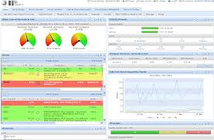
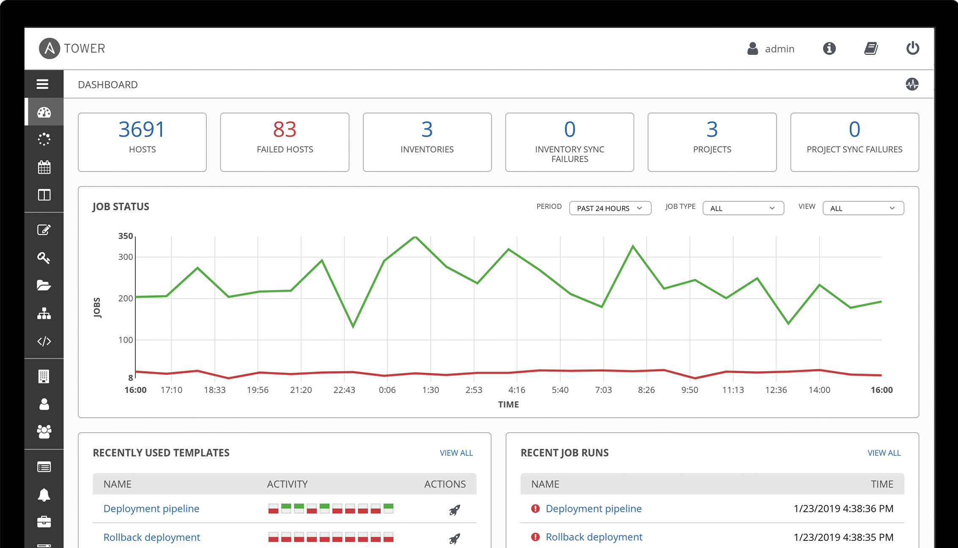
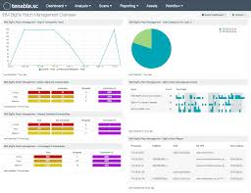
Partnering with Red Hat to Modernize for the Future
Red Hat acquisition has allowed to modernize our automation engine and approach to automation development.
Leverage new technologies that embrace hybrid cloud management, operations, and automation.
Expand automation capabilities and expertise by tapping into IBM’s large service delivery organization to cultivate and grow automation for clients.
Automated Incident Remediation
Patch Scanning and Execution
Cloud Automation Community Framework (CACF)
Health Checking and Automated Enforcement
(Security and Compliance)

Slide 10

CACF – Deployment Models
Build and Steady State/BaU Management
Aligned to CACF Standard Architecture & Delivery
Not CACF
100% HST
Partial to Full HST
Account Team
Account Team
Shared 1
Ded 1
Shared 2
Ded 2
Ded 3
Non Std
Support Legend
HST-Tower Team
Multi-Tenant Ansible Tower Instance
Dedicated
Ansible Tower Instance
Multi-Tenant Ansible Tower Instance
Dedicated
Ansible Tower Instance
Dedicated Ansible Tower Instance
Non CACF Ansible Tower Instance
HST-ISPwW
HST-Account Squad
Dedicated OCP
Dedicated OCP
Dedicated OCP
Dedicated OCP
Dedicated OCP
Non std OCP or VMs
HST or Other IBM org
Account Team
Not Geo HST
ISPwW Standard Infrastructure (IBM Cloud)
IBM Cloud/IBM DC/Customer DC
IBM Cloud/
IBM DC/
Customer DC
IBM Cloud/
IBM DC/
Customer DC

Slide 11
Pre-boarding requirements
Overview
In scope Supported Platforms
Account GitHub Organization
Managed Endpoints
Jump Hosts
Credentials
Infrastructure
Network
Integrations
Education
A GUI dashboard

Slide 12
Continuous Engineering

Slide 13
Community Model - Governing Principles
Platform - Available to everyone @Kyndryl. Easy access to solutions and ideas.
Best Practices – Coding, testing, open-source licensing recommendations and more.
Content Driven by the crowd - Any asset can be part of the platform; code curation is offered.
Controlled Execution - Accounts will determine what automation they will deploy via Ansible Tower RBAC model.
Enable Community – Role based learning plans, targeted buddy programs, hackathons, structured recognition (cash, badges, etc)
Engage Community – Extended community base, Invent it only once and distribute it globally
Continuous Engineering
Platform
Community
Best Practices
https://pages.github.ibm.com/Continuous-Engineering/
CE Slack
https://ibm-hcs.slack.com/archives/CJHFT0U67
#guild-ansible
https://ibm-hcs.slack.com/archives/CEXS8JF4J

Slide 14
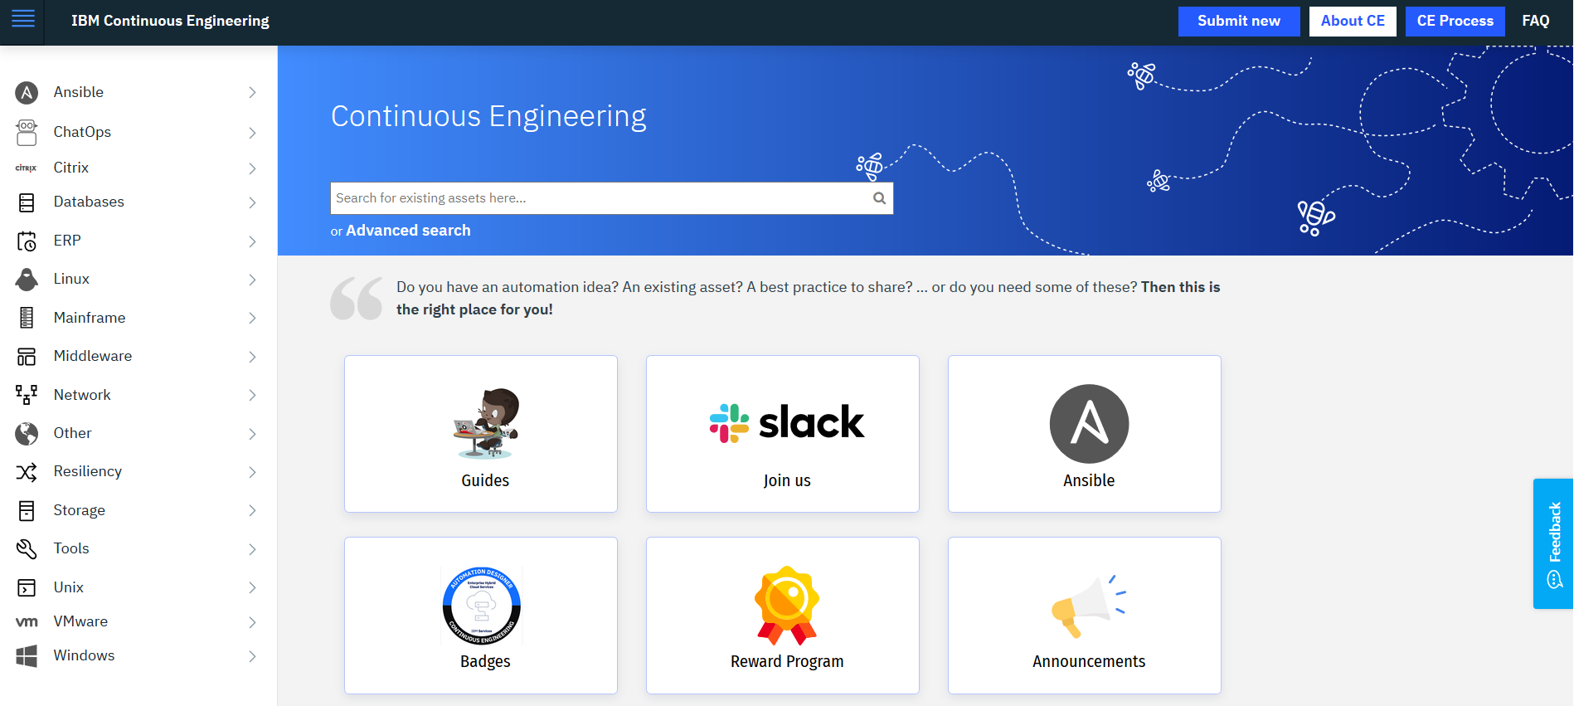




Continuous Engineering Journey
2020/Beyond
Pivot to Ansible ; Community vitality
Enhanced CE Platform - V2.0 (Automated – Repo creation, testing, chatbots, Integrated search and more)
Enablement
Publish learning plans, Account enablement packages
Structured Rewards, Badge to recognised crowd contribution
Advocate Programme
Engagement
Repeatable Hackathons, roadshows, Meet ups and more
Extended community by enabling CICs and GSEs.
Drive content and community Contribution
Execution - Consumption of community assets
Metrics and Measurements – identifying trends and gaps – fed into the system for improvements.
2019
Continuous Engineering Launch - Formation
Community-enabled platform
Available to everyone @IBM
Invent it only once and distribute it globally
Easy access to solutions and ideas
Curated assets
CICs – leadership community established. Crowd motivation factors identified
Readiness to support Ansible @IBM
Call4Automation Global Automation Challenge launched
Metrics and Management system
2018
Where are we? - Legacy
Local Automation mushroom due to unaddressed opportunities by strategic automation
Delivery teams working in isolations – duplicating efforts
Lack of Single Global Repo to share automation, best practices across delivery teams
Community skills not put to greater use

Slide 15
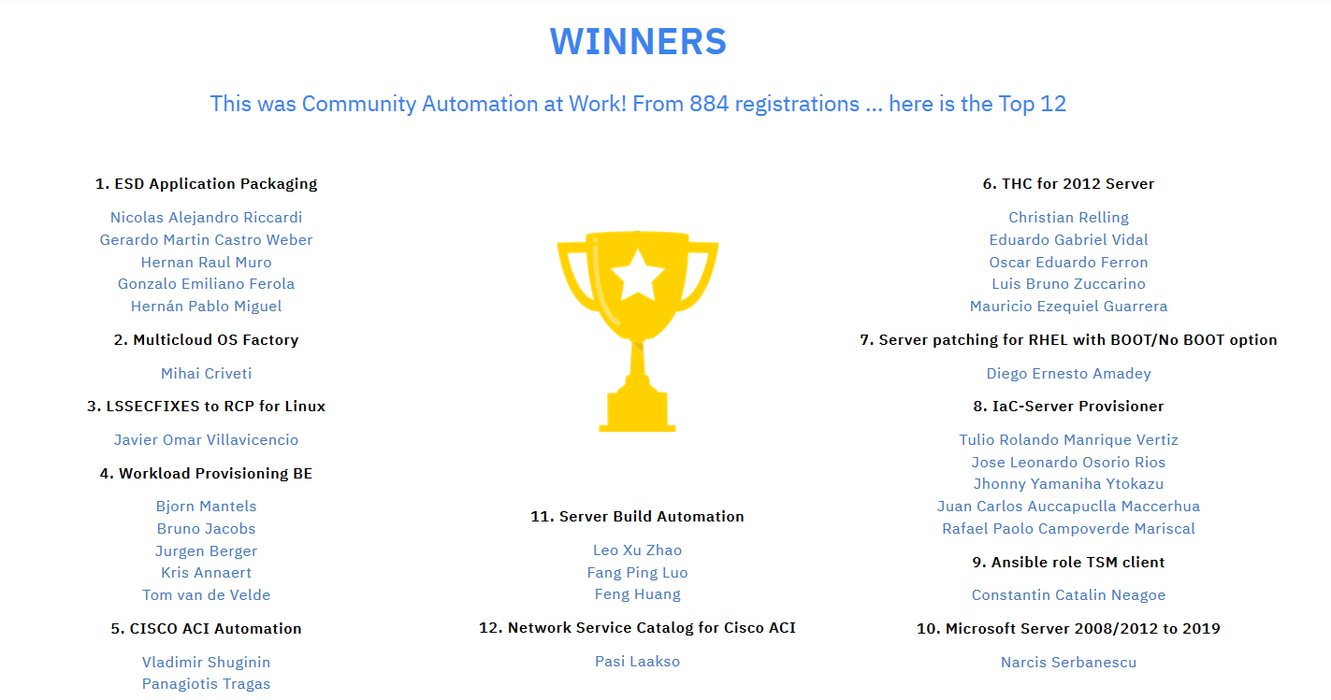

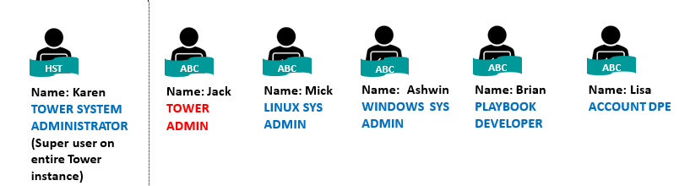
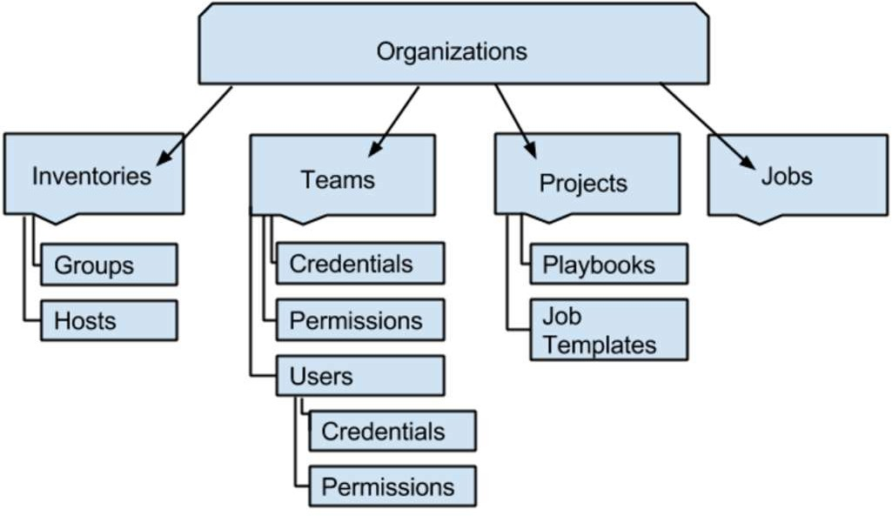
How are we developing/deploying content?
Ansible Tower RBAC Model
Enables an account to have full control over E2E automation deployment
Flexibility to choose
WHAT automation playbooks are deployed on account
WHERE to source the playbooks from (various GitHubs)
WHEN they are deployed / upgraded
WHO deploys them and consumes them
User Guides, Best Practices
Assets Migrated and Community developed
Asset Management /curation
Structured recognition
Community Enablement and Engagement
Drive enablement through curated learning plans and advocate programme
Encourage crowd learning through hackathon, bootcamps and meet-ups
Rewards and Recognition(cash, badges)
Provide a platform for community sourced automation and best practice based on Github & Ansible Galaxy
Global best practice for ansible playbook development and usage
Measure and analyse automation consumption to help target community development and automation adoption
Leveraging the Global Services engineering service and GEO aligned teams
Engagement
Use/Contribute
Account View
Tower Account Administrator:
Gatekeeper for account user access and permissions
Controls what automation is deployed and who can consume the automation (ensuring change compliance)
Aligns the Tower RBAC permissions of authorized users and teams to Tower objects (i.e. inventories, projects, jobs)
Deep knowledge of account support model and automation taxonomy
Entrusted with credentials management
Change
Managed
Execution
(Account change management process followed)
Enable accounts

Slide 16
Collateral and Key Links

Slide 17
Resources and Forums for Help
Description | Click Link to Access
Ansible Program | Cloud Automation Community Framework Publisher Page
Asset Catalogues | CACF Ansible Automation - Catalog
Account Enablement Education Package | CACF Account Enablement Education Package
Delivery Cost Guidance | CACF Delivery Cost Guidance
Engagements and Onboarding | CACF Engagements and Onboarding
Architecture Docs | CACF Technical Work products
Test environments | Dev and Test Environments
Lunch and Learns | Lunch and Learn Agendas and Sign Up
AAP Migration plan | AAP migration related links

Slide 18
YAML

Slide 19
YAML Introduction
YAML stands for yet another markup language, it is a popular programming language because it is designed to be easy to read and understand.
It can also be used in conjunction with other programming languages. Because of its flexibility and accessibility, YAML is used by the Ansible automation tool to create automation processes, in the form of Ansible Playbooks.
YAML files use a .yml or .yaml extension and follow specific syntax rules.
YAML has features that come from Perl, C, XML, HTML, and other programming languages. YAML is also a superset of JSON, so JSON files are valid in YAML.
YAML files are simpler to read as they use Python-style indentation to determine the structure and indicate nesting.
Ansible Playbooks are used to orchestrate IT processes. A playbook is a YAML file containing 1 or more plays and is used to define the desired state of a system.
Each play can run one or more tasks, and each task invokes an Ansible module. Modules are used to accomplish automation tasks in Ansible. Ansible modules can be written in any language that can return JSON, such as Ruby, Python, or bash.

Slide 20
YAML Syntax
Example-1:
---
- name: Update web servers
hosts: webservers
remote_user: root
tasks:
- name: Ensure apache is at the latest version
ansible.builtin.yum:
name: httpd
state: latest
- name: Write the apache config file
ansible.builtin.template:
src: /srv/httpd.j2
dest: /etc/httpd.conf
Example-2:
---
- name: Update db servers
hosts: databases
remote_user: root
tasks:
- name: Ensure postgresql is at the latest version
ansible.builtin.yum:
name: postgresql
state: latest
- name: Ensure that postgresql is started
ansible.builtin.service:
name: postgresql
state: started
Ansible Modules link: https://docs.ansible.com/ansible/2.8/modules/modules_by_category.html

Slide 21
YAML Syntax
Example-3:
---
- name: Installing Apache MSI
hosts: win
tasks:
- name: Download the Apache installer
win_get_url:
url: https://archive.apache.org/dist/httpd/binaries/win32/httpd-2.2.25-win32-x86-no_ssl.msi
dest: C:\ansible_examples\httpd-2.2.25-win32-x86-no_ssl.msi
- name: Install MSI
win_package:
path: C:\ansible_examples\httpd-2.2.25-win32-x86-no_ssl.msi
state: present
Example-4:
---
- hosts: win
tasks:
- name: Creating a registry
win_regedit:
path: HKLM:\SOFTWARE\GeekFlare
- name: Modifying a registry, adding name and data
win_regedit:
path: HKLM:\SOFTWARE\GeekFlare
name: Geek
data: Flare

Slide 22
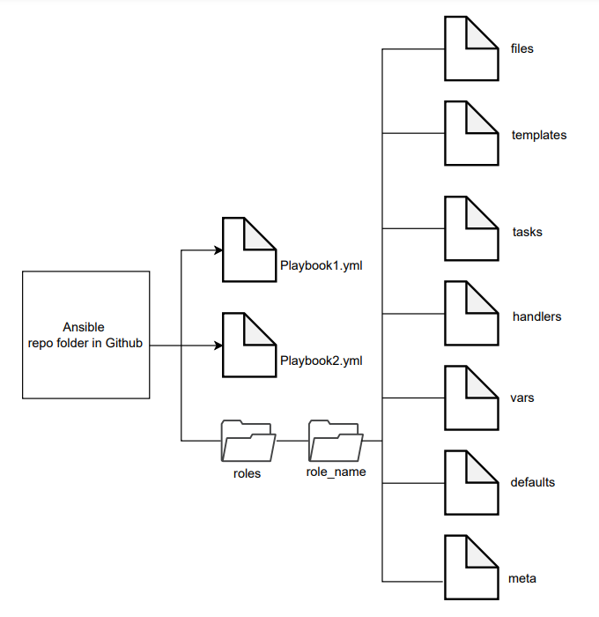
Best Practices in playbooks
Reference Link: Ansible playbook Best Practices

Slide 23
Demo Ansible Tower
Views
Dashboard overview
- Activity streams
Jobs
Schedules
My View
Resources:
Templates
Credentials
Projects
Inventory management
Inventory Scripts
Access:
Organizations
Users
Teams
Administration:
Notification
Instance Groups
Applications
Reference Link: Ansible playbook Best Practices

